Slide 1
NISQ-era quantum algorithms Variational algorithms and potential applications
Shesha Raghunathan
Senior Engineer, IBM Systems

Slide 2
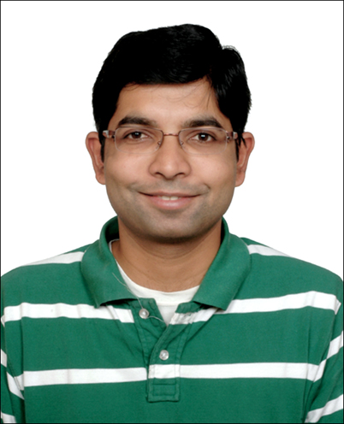
Shesha Raghunathan
SR is a Senior Engineer with IBM Systems. He is part of Electronic Design Automation (EDA) team and works on timing analysis tools. He is also an IBM Quantum Distinguished Ambassador, a Qiskit Advocate and an IBM Quantum Technical Ambassador; he leads Ambassador program in ISA. He has multiple publications in the area of Quantum Computing, Reconfigurable Computing, Timing Analysis and has multiple patents to his name. SR got his PhD in Quantum Computing from University of Southern California in 2010.

Slide 3
Motivation
Why Variational Quantum Algorithms?

Slide 4


Quantum Computing Generations NISQ (Noisy Intermediate-State Quantum)
Experimental
NISQ
Fault-Tolerant
1981
2016
2021
20XX
Quantum 2, 79 (2018)

Slide 5

Quantum algorithms: history
Variational Quantum Algorithms (VQA)
QML
Pricing option contracts
VQE
Deutsch
-Jozsa
Bernstein
-Vazirani
QC in cloud
Battery
optimization
Simon
Shor
Grover
QAOA
…
…
1992
1992
1993
1994
1996
2014
2016
2018 -
Notes:
TODO: Create a detailed history chart for all algorithms for more advanced courses.

Slide 6
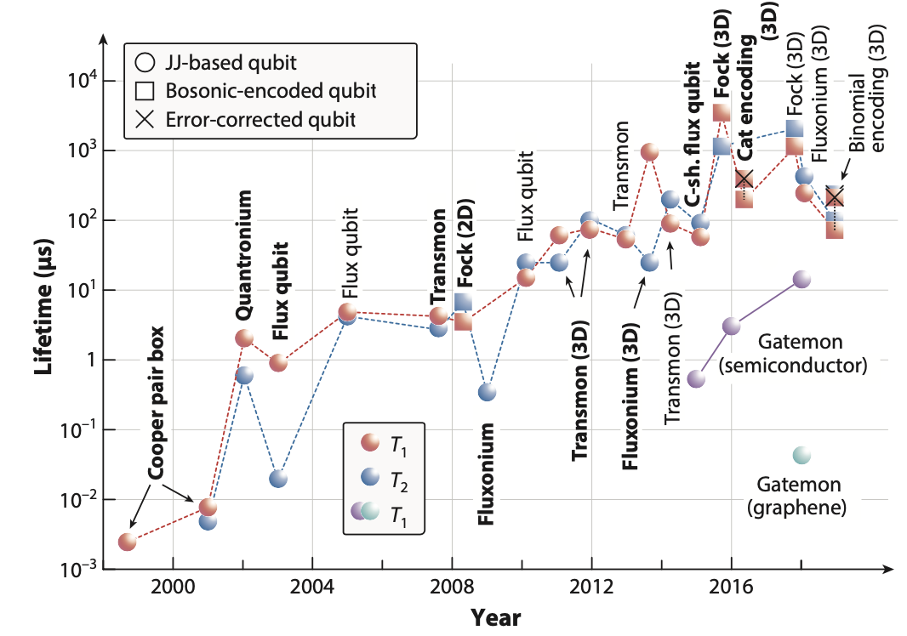
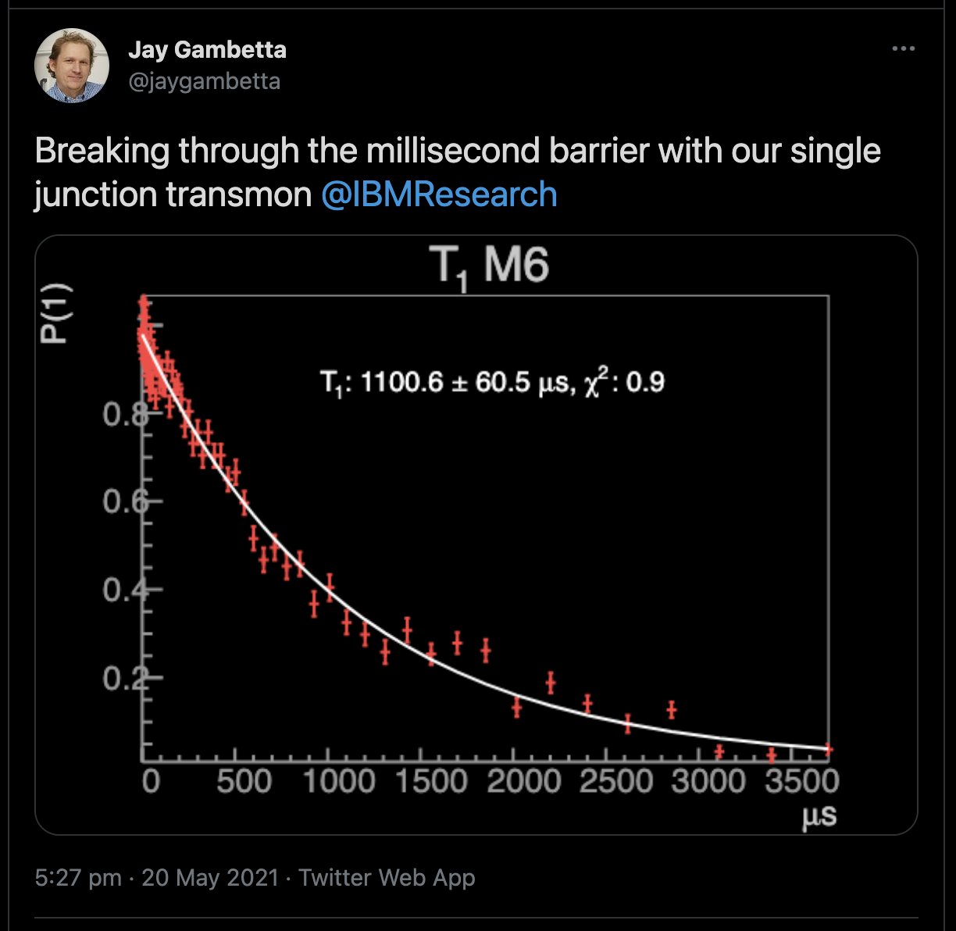
Qubit lifetime Superconducting qubits
Annu. Rev. Condens. Matter Phys. 2020. 11:369–95.

Slide 7
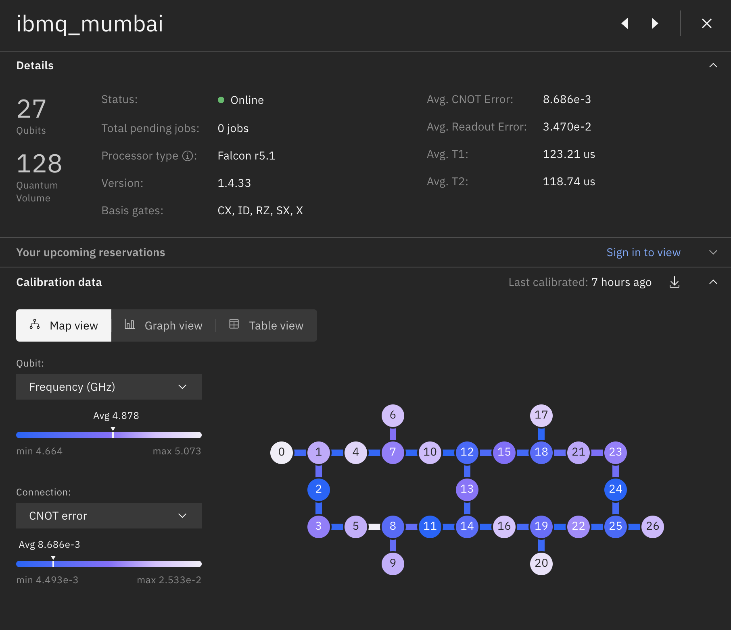
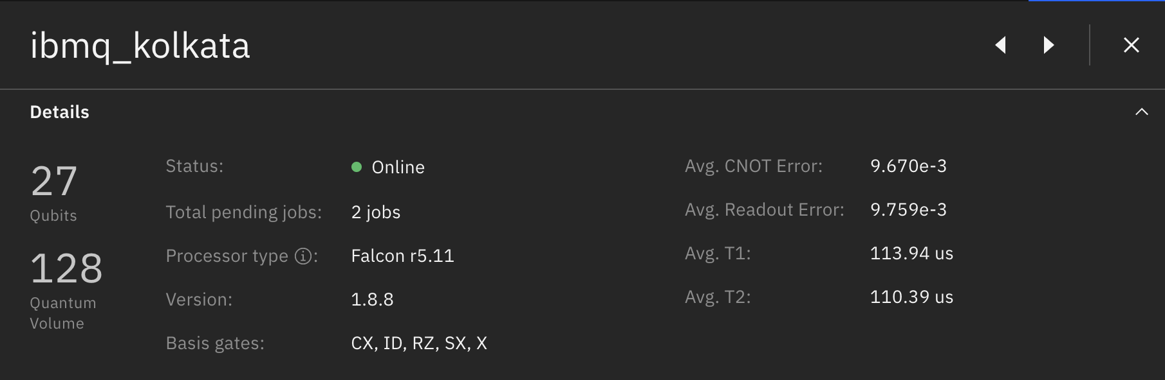
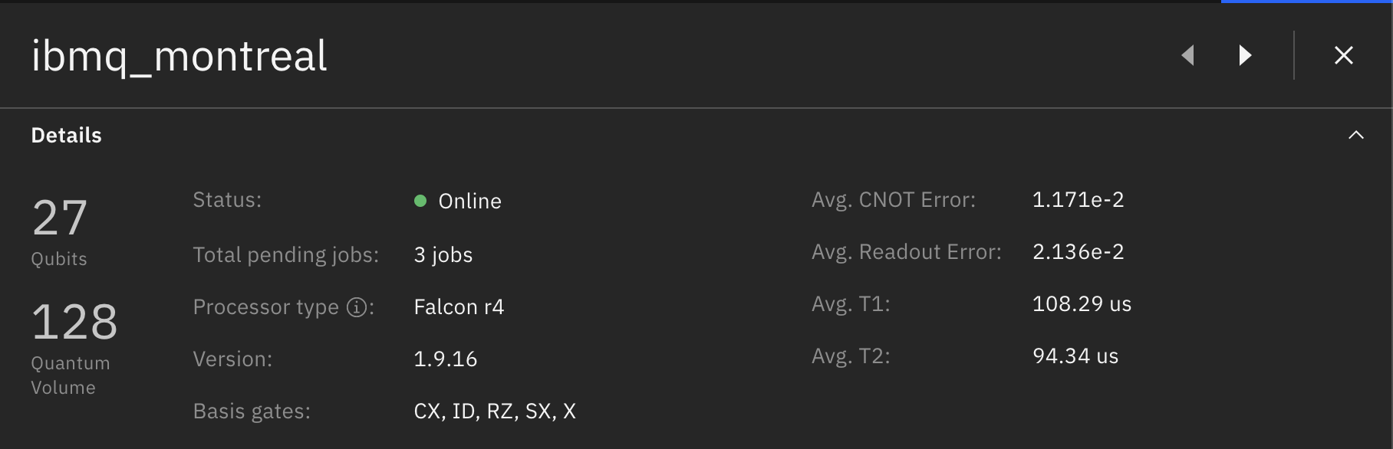
Why Variational Algorithms?
Noise, noise, noise…
https://quantum-computing.ibm.com/catalog/services
Date accessed: 10/Jul/2021

Slide 8
Variational Quantum Algorithms (VQA)
Why? What? How?

Slide 9
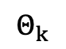
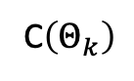
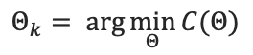
Structure
Training set, Cost function, Ansatz*
Classical-Quantum Hybrid Optimisation
Quantum
(Shallow circuit approximating cost function)
C$\left(Θ_{k}\right)$
Classical optimization
(Optimise for parameter)
$$Θ_{k}$$
$$Θ_{k}= arg{\min_{Θ}{C(Θ)}}$$
Ansatz*: initial estimate of the solution

Slide 10
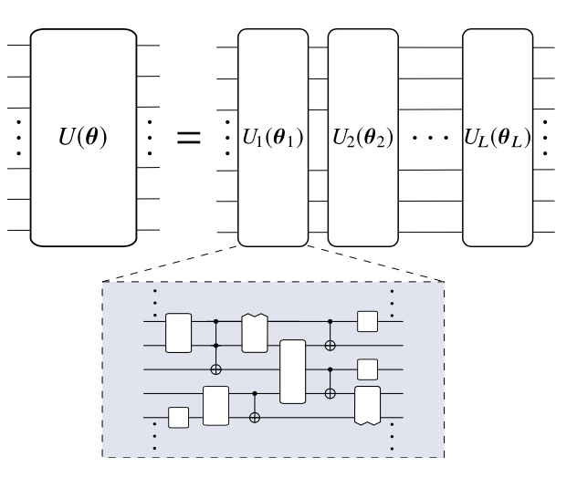
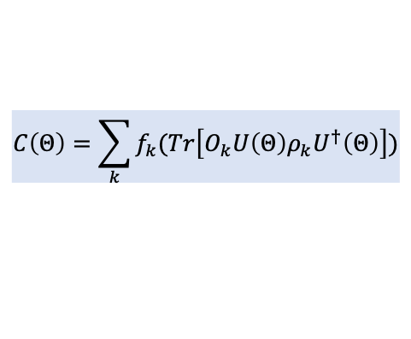
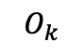
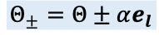
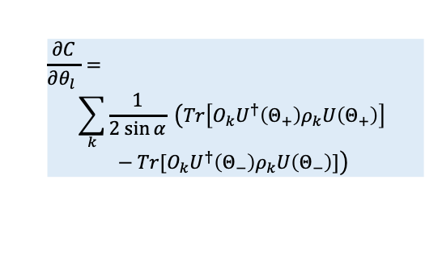
Building blocks or components
Cost function
Ansatz
Gradients
Classical optimizers
Challenges:
Number of measurements
Hardware noise
Barren plateau
$$C\left(Θ\right)=\sum_{k}{f_{k}(Tr\left[O_{k}U\left(Θ\right)ρ_{k}U^{†}\left(Θ\right)\right])}$$
Problem-inspired
Problem-agnostic
Parameter-shift rule:
$$\frac{∂C}{∂θ_{l} }=$$
$$\sum_{k}{\frac{1}{2 sin{α}} \left(Tr\left[O_{k}U^{†}\left(Θ_{+}\right)ρ_{k}U\left(Θ_{+}\right)\right] −Tr[O_{k}U^{†}\left(Θ_{−}\right)ρ_{k}U\left(Θ_{−}\right)]\right)}$$
Desirable criteria:
Faithful – min corresponds to solution
Efficiently estimatable – realizable in a shallow quantum circuit
Operationally meaningful
Trainable
Approaches (quantum-aware):
Stochastic gradient descent
Quantum natural gradient descent
SPSA
Gradient-free
$$Θ_{±}=Θ±αe_{l}$$
NOTE: Accuracy depends on sampling
$$O_{k}$$
Trade-off: precision vs step-size
Arxiv:2012.09265

Slide 11
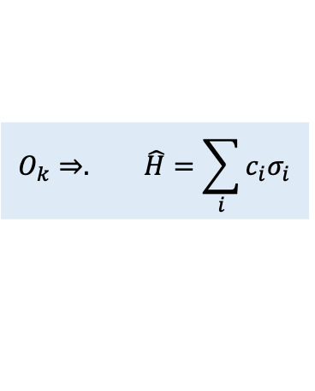
Challenges
Trainability
Efficiency
Accuracy
Barren Plateau (BP)
Problem: Estimate expectation value efficiently (related to number of measurements)
Impact of hardware noise
Exponentially vanishing partial derivative
Randomly initialized deep QCs exhibit BP
Shallow random: connection b/w locality and trainability
Noise => BP regardless of ansatz
Typically, noise slows down training
Noise induced BP => difficult trainability
Noise impacts cost function evaluation
$$O_{k}⇒. \hat{H}=\sum_{i}{c_{i}σ_{i}}$$
Noise resilience + error mitigation
Approaches
Ansatz + initial strategies
VQAs are resilient to coherent errors
In some cases global min of noisy cost function corresponds to true global min
Zero-noise extrapolation
Probabilistic error mitigation using near-Clifford circuits
Subspace expansion: works better for coherent noise than stochastic noise
Challenge: number of terms
Pauli strings: commuting + non-commuting
Improve measurement efficiency by allocating num shots as a function of co-eff
Classical shadow or shadow tomography
Neural network tomorgraphy
Parameter initialization: very important
Far from sol (local min) or hitting BP
Pre-train using ML techniques
Problem inspired structured ansatz
Optimizers tailored to mitigate BP
Arxiv:2012.09265

Slide 12
Derivatives It’s a zoo out there
Variational Quantum Eigensolver (VQE)
Quantum Approximate Optimization Algorithm (QAOA)
Variational Quantum Thermalizer
qEOM-VQE
Variational Quantum State Diagonalization
Chemistry/Physics
Variational Quantum Deflation
Variational Quantum Hamiltonian Diagonalization
Quantum GANs
Quantum Classifiers
Quantum Optical Neural Networks
QML
Quantum Graph Recurrent Networks
Quantum CNNs
…. and many many more

Slide 13
Potential use-cases
Improving nitrogen fixation
Option pricing
New battery materials
Transaction settlement
Customer segmentation
Electronics materials
New class of antibiotics
Drug discovery
Loan and credit scoring
Fraud detection
Chemical observable prediction
Protein folding
Portfolio optimization
QChem/Mat/LifeSci
Logistics and routing optimization
Finance
Supply-chain optimization
Manufacturing optimization
Variational optimization/factoring
Logistics/optimization

Slide 14
Variational Quantum Eigensolver (VQE)
Application: Quantum chemistry simulation

Slide 15
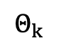
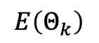
Classical-Quantum Hybrid Algorithm
Hamiltonian mapping
Initial trail state (ansatz)
Choose classical optimizer (setup)
Hybrid Classical-Quantum Optimization
Quantum
(Find energy for trial state)
$$E\left(Θ_{k}\right)$$
Classical optimization
(Find min energy)
$$Θ_{k}$$
Nat. Commun 5, 4213 (2014)

Slide 16
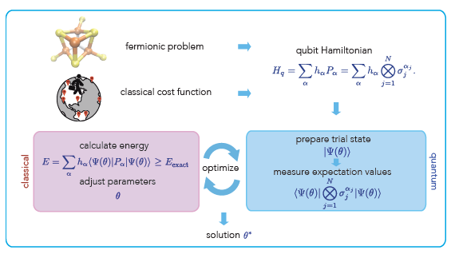
Solution framework
Fermionic-Qubit Hamiltonian mapping?
Choice of classical optimizer?
Initial ansatz?
arXiv:1710.01022

Slide 17
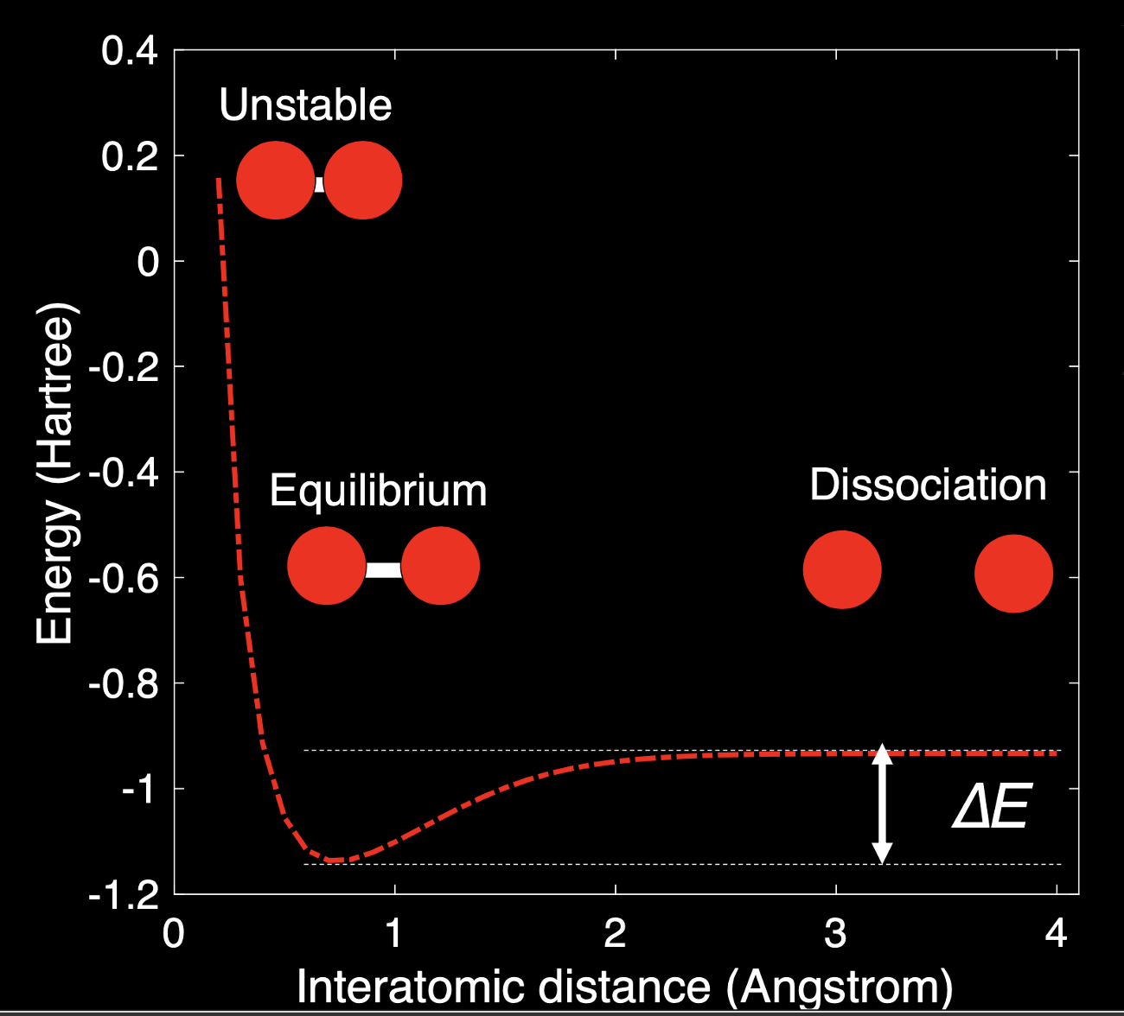
Potential energy curve of a molecule

Slide 18
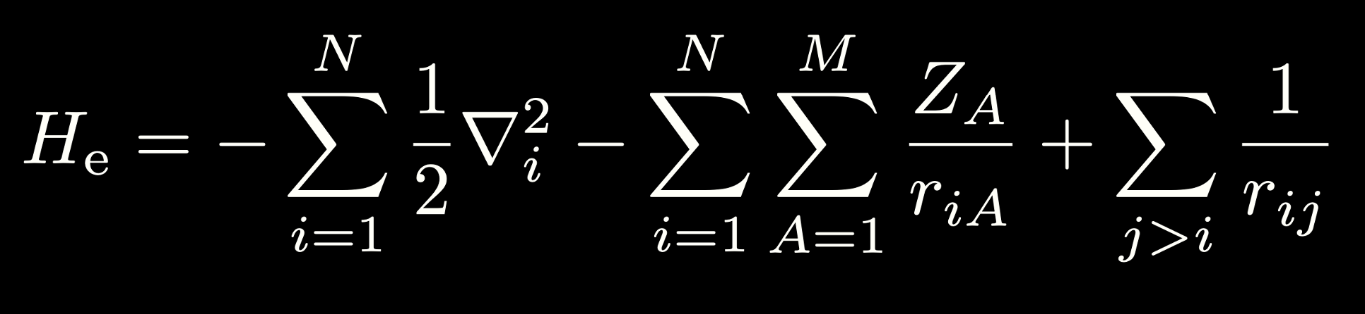
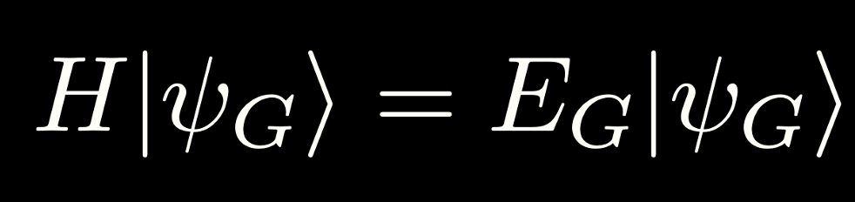
Fermionic or Electronic Hamiltonian
*Born-Oppenheimer approximation

Slide 19
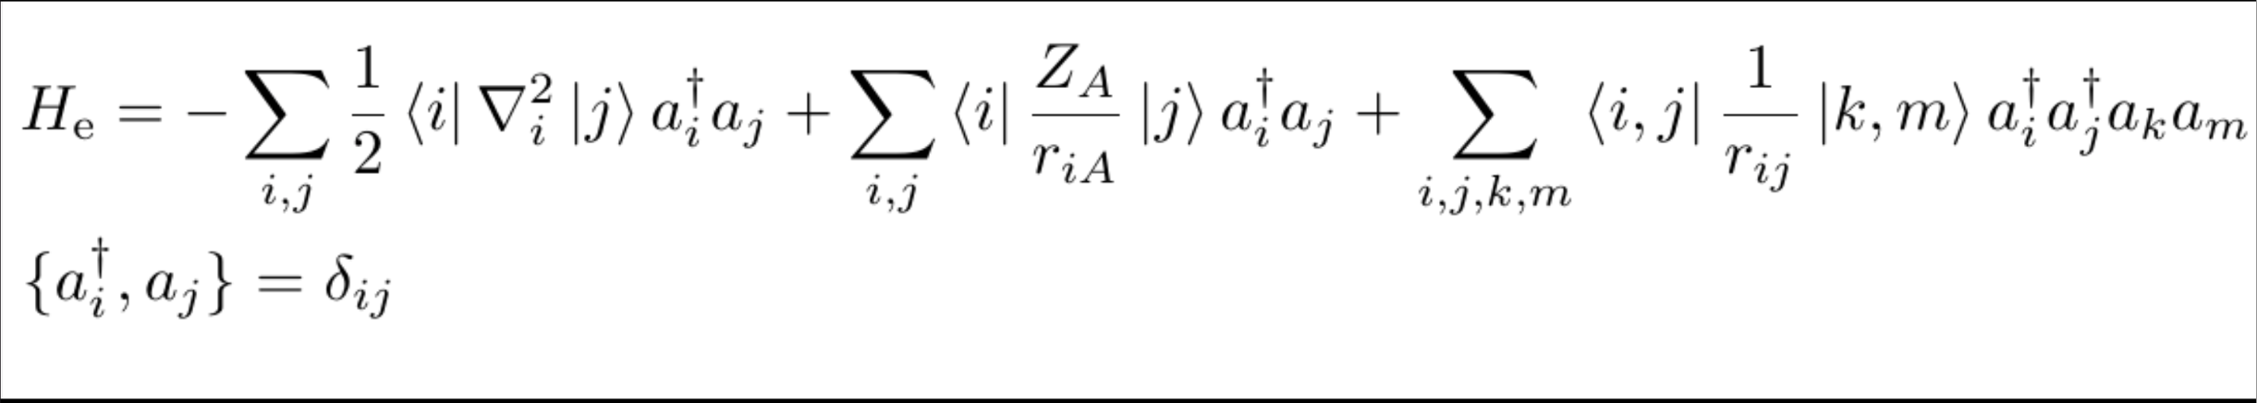
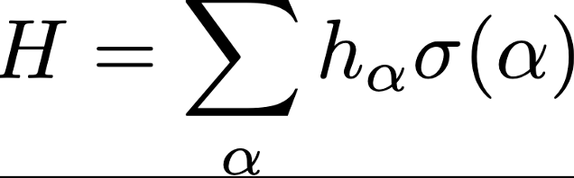

Hamiltonian mapping Electronic → Qubit
Jordan-Wigner, Brayvi-Kitaev, Parity mapping etc

Slide 20
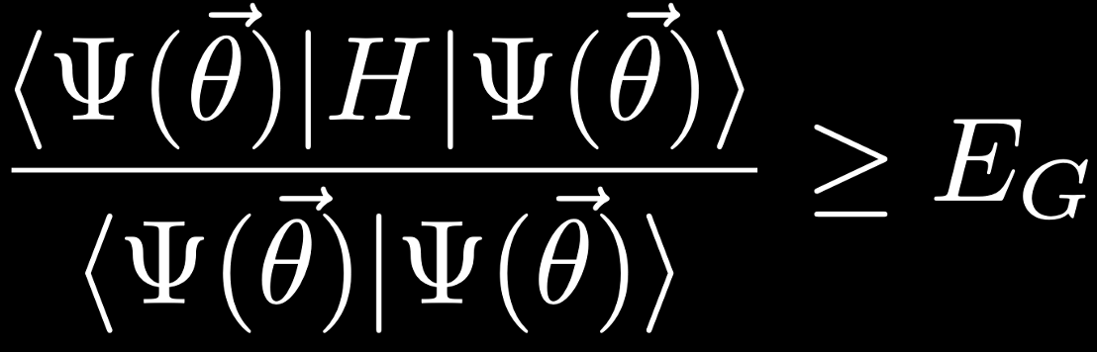
Variational principle
Energy of trial state is greater than or equal to ground state energy

Slide 21
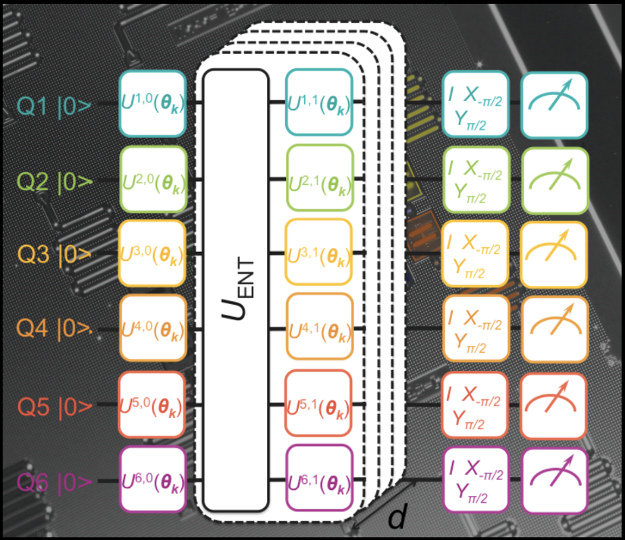
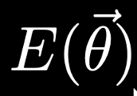


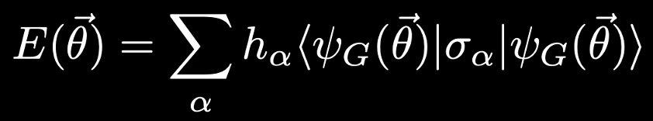
Quantum-Classical Hybrid Algorithm
Classical optimizer
Qubit Hamiltonian
Energy measured
Kandala et al, Nature, 549, 242-246 (2017)

Slide 22
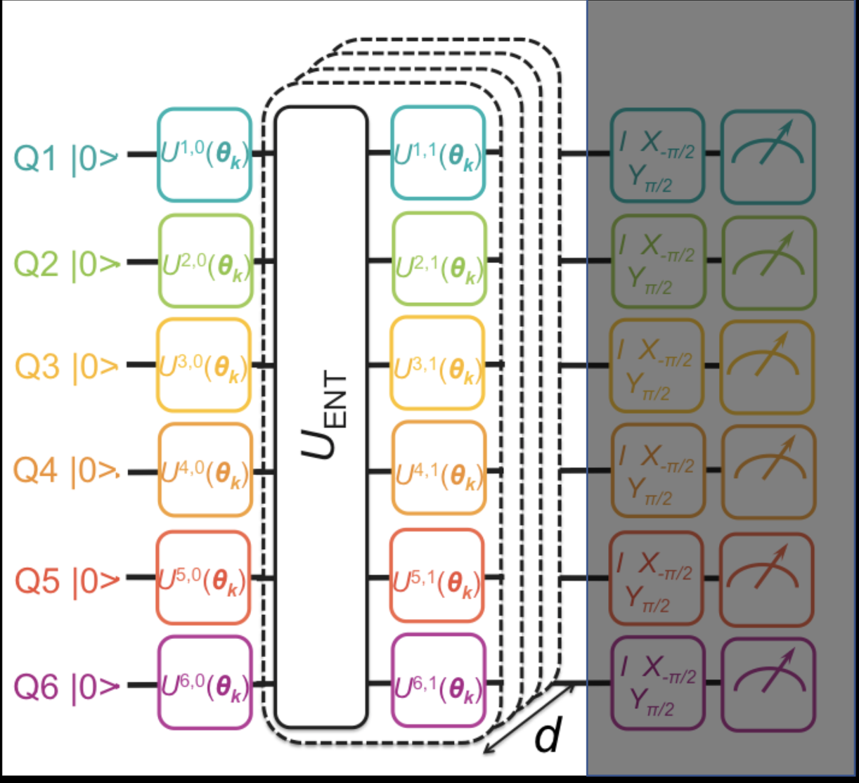
Trial state preparation
Entangling gates (2 or higher) sandwiched b/w single qubit rotations
‘d’ is the number of layers and is a function of available depth or coherence time
Choice of trial state ansatz: traditional or hardware sensitive ones

Slide 23
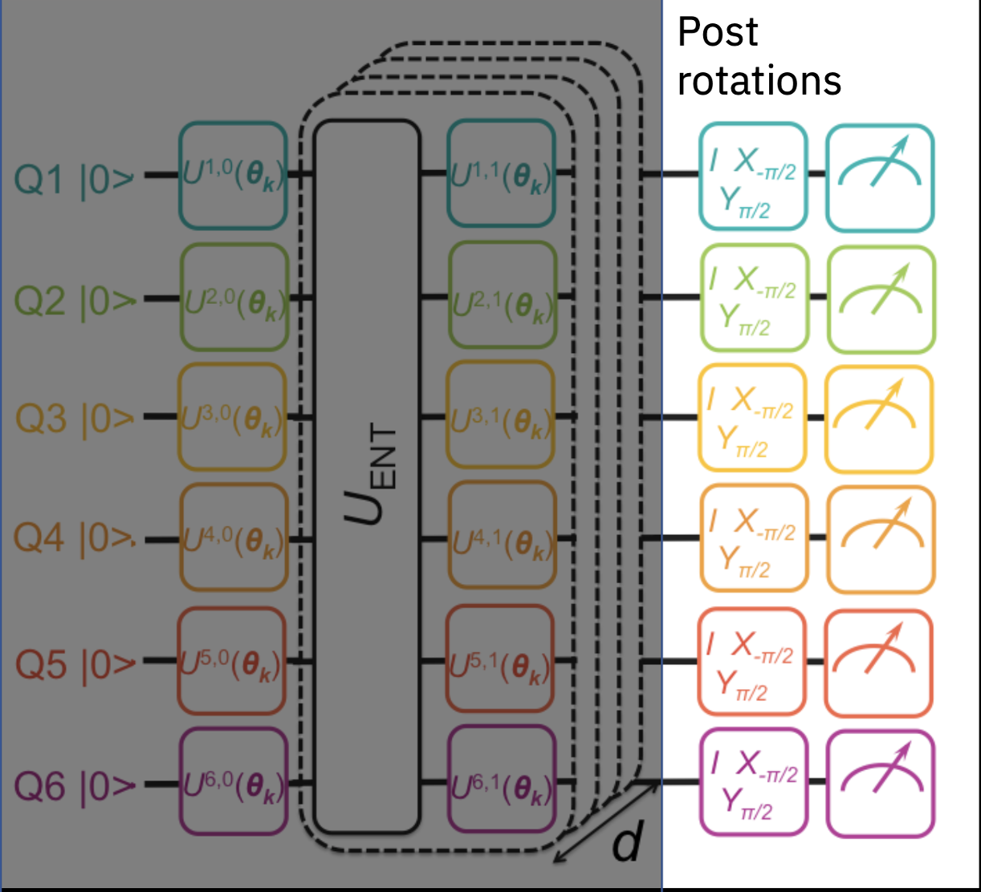
Measurement
Sample Qubit Hamiltonian
H = h₁ IXYZ + h₂ XZZX + h₃ XZZY
Energy measured

Slide 24
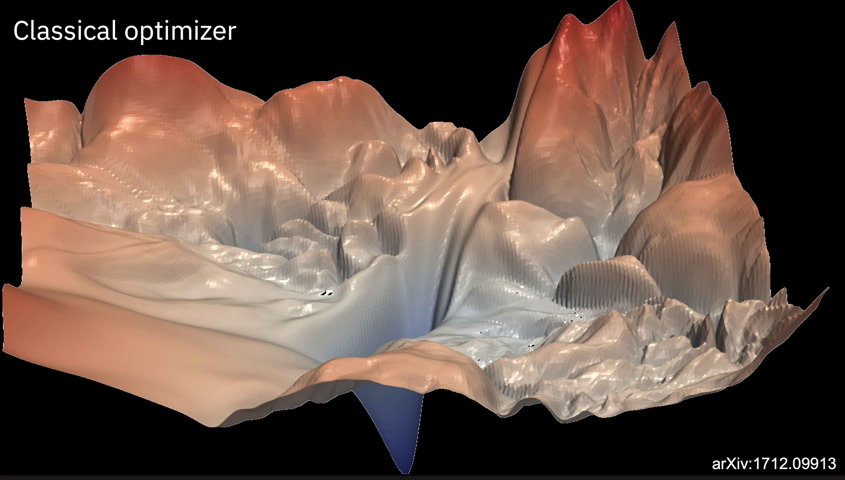
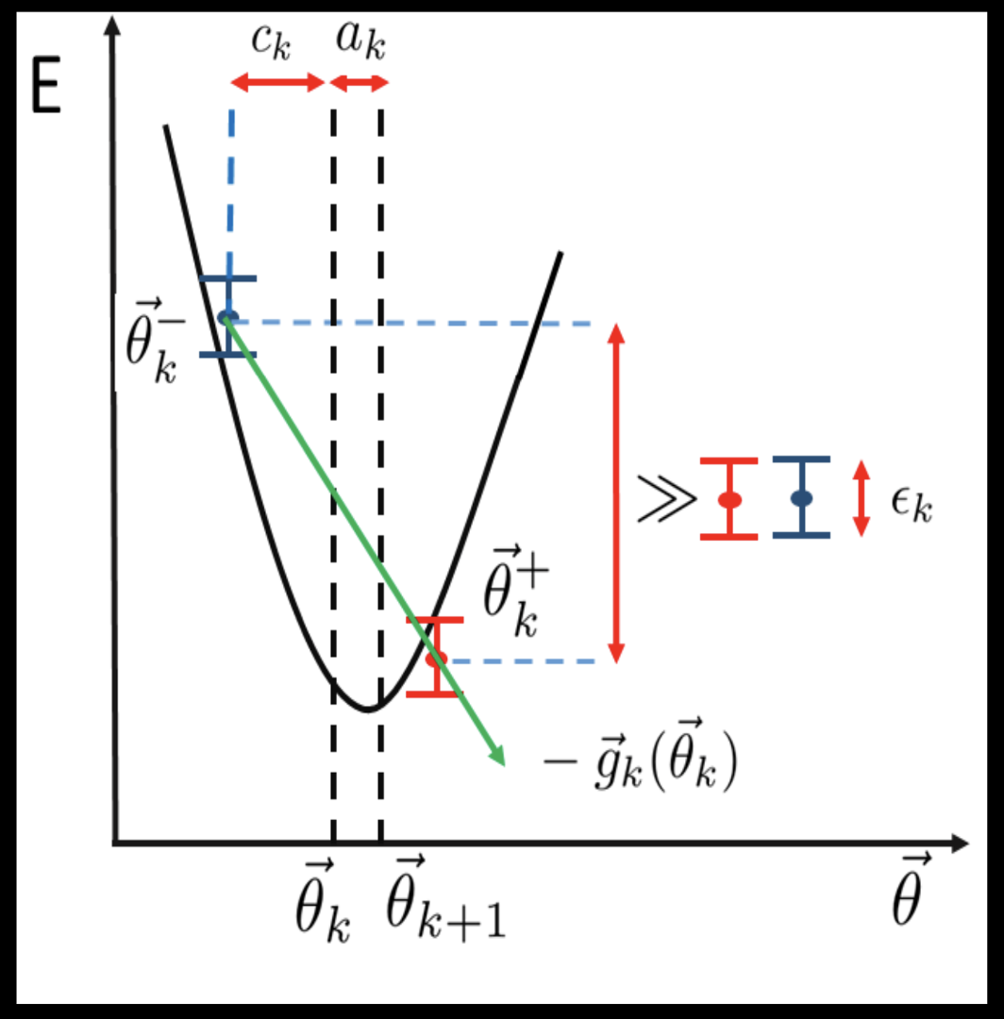
Simultaneous Perturbation Stochastic Approximation (SPSA)
Key take-aways
Reduce number of calls to quantum computer
Gradient approx. (SPSA): two calls per iteration irrespective of optimization dimension
Kandala et al, Nature, 549, 242-246 (2017)

Slide 25
Quantum Generative Adversarial Networks (qGANs)
Application: Option Pricing in Finance

Slide 26
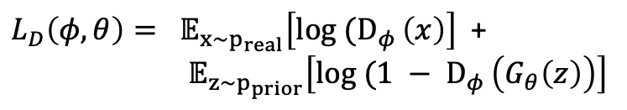
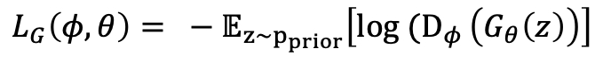
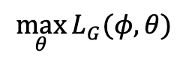
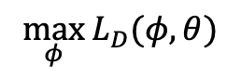
Generative Adversarial Networks (GANs)
Idea: Training process
Training (real) data samples
Data samples
Generator (G)
Discriminator (D)
Real/Fake
Loss functions
Nash equilibrium of 2-player game
$L_{G}\left(φ, θ\right)= − 𝔼_{z\sim p_{prior}}\left[log (D_{φ }\left(G_{θ}\left(z\right)\right)\right]$
$$\max_{θ}{L_{G}(φ, θ)}$$
$L_{D}\left(φ, θ\right)= 𝔼_{x\sim p_{real}}\left[log (D_{φ }\left(x\right)\right]$ +
$𝔼_{z\sim p_{prior}}\left[log (1 − D_{φ }\left(G_{θ}\left(z\right)\right)\right]$
$$\max_{φ}{L_{D}(φ, θ)}$$

Slide 27
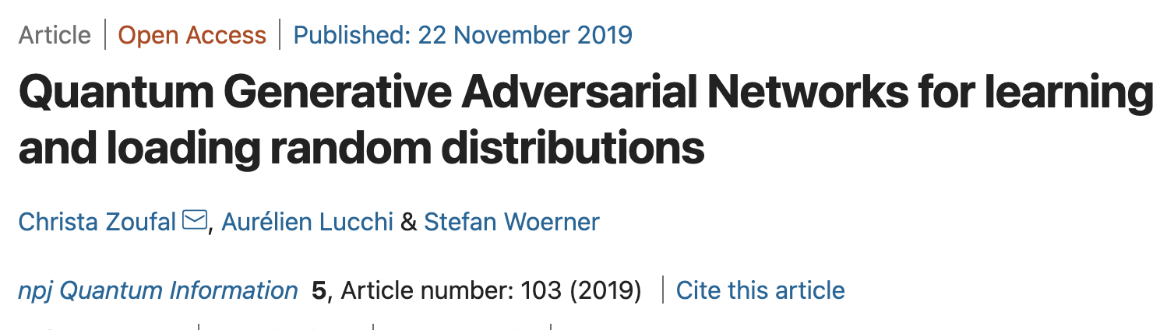
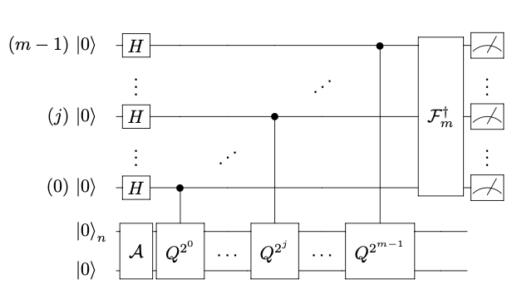
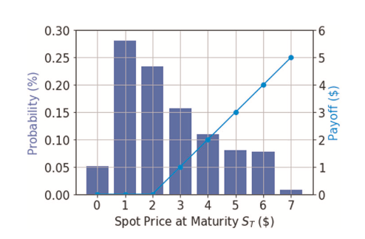
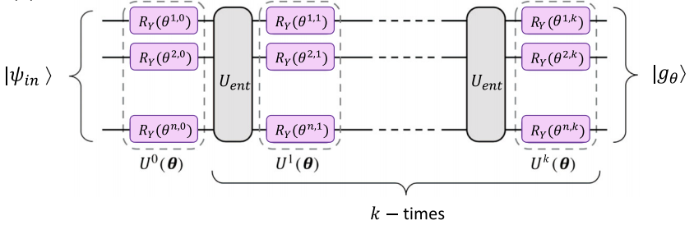
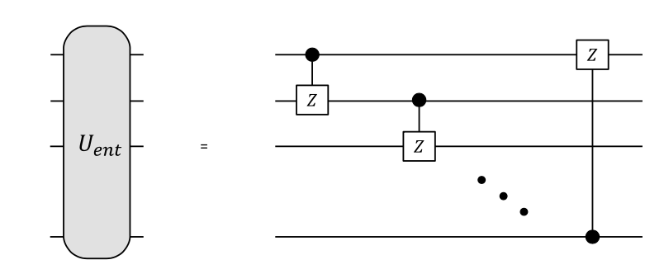
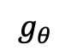
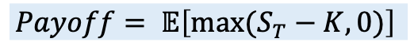
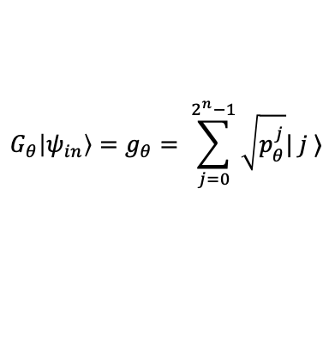
European call option* spot pricing
$$g_{θ}$$
Payoff
Key take-aways
Problem addressed: “data loading” problem
qGANs framework: quantum generator + classical discriminator
Demonstration: European call option pricing in finance
Link: https://ibm-q-financial-demo.mybluemix.net/
npj Quantum Inf 5, 15 (2019)
Quantum Generator
$$G_{θ}\left|ψ_{in}\right\rangle =g_{θ}= \sum_{j=0}^{2^{n}−1}{\sqrt{p_{θ}^{j}}| j ⟩}$$
$$Payoff= 𝔼\left[max⁡(S_{T}−K, 0)\right]$$
* https://www.theoptionsguide.com/call-option.aspx

Slide 28
Demo
VQE: https://qiskit.org/textbook/ch-applications/vqe-molecules.html
qGANs: https://ibm-q-financial-demo.mybluemix.net/

Slide 29
Summary
Programmable quantum computing is a reality and NISQ era is upon us
Hardware evolution quite rapid but still “noisy”
Traditional quantum algorithms are not practical
Variational quantum algorithms are mainstay in NISQ era (and even beyond)
Hybrid classical-quantum algorithm with shallow depth circuit
Hand-crafting of components: cost-function, ansatz, gradients and classical optimizers
Challenges: trainability, efficiency, accuracy
Many flavours of variational algorithms being explored
Potential use-cases span financial, natural sciences, health sciences, manufacturing and logistics

